Slide 1


When Older Adults Delegate Taxes:
Socio-Technical Issues
Dr. Celine Latulipe (presenter)
Luke Wiebe
Zach Havens
Dr. Mohammad Khan

Slide 2
Outline
Background
CRA Delegation Mechanisms
Interview Study
Results
Takeaways

Slide 3
The increasingly digital tax landscape
Many employers and organizations provide digital tax forms by default
While still possible to file taxes on paper, it is not encouraged
Tax software enables:
Auto-fill a Return pulls forms from CRA using Social Insurance Number
File electronically
Validation
Simplified process, calculations pre-populated
Some older adults may struggle with this digital landscape and rely on others to do their taxes for them.

Slide 4
Background
Canadians who file taxes:
33,839,390
Filing taxes in Canada → social benefits
In 2025, 33.8 million Canadians filed taxes
Half prepare & file their own taxes
Half have someone else do it for them:
  CVITP (~1 million)
  Friend or family member (~3.3 million)
  Accountant or tax preparer (H&R Block, etc.) (~12 million)
CVITP
Half have someone else do their taxes for them:
16,919,695
Pay an accountant or a tax service to prepare & file taxes
~12 million
1/5 of these rely on a friend/family member
> 3 million
Canada Revenue Agency 2022–2023 ePayroll Public Opinion Research. Nanos Research. (Registration Number: POR-135-22) ISBN: 978-0-660-49952-9

Slide 5
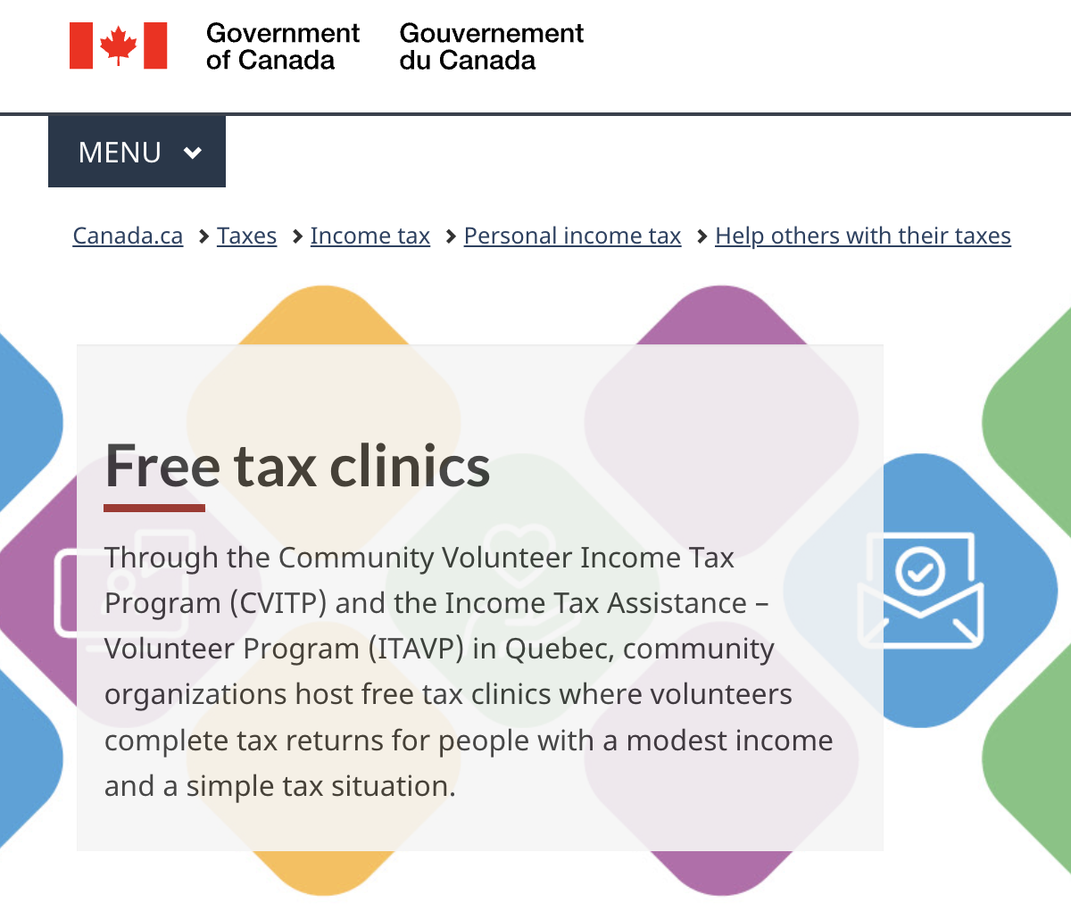
CVITP
Canadian Volunteer Income Tax Program
Complete simple tax returns for low-income people for free
Trained volunteers through certified community organizations
Volunteers are provided temporary (one-day) access to CRA accounts of the clients they help

Slide 6
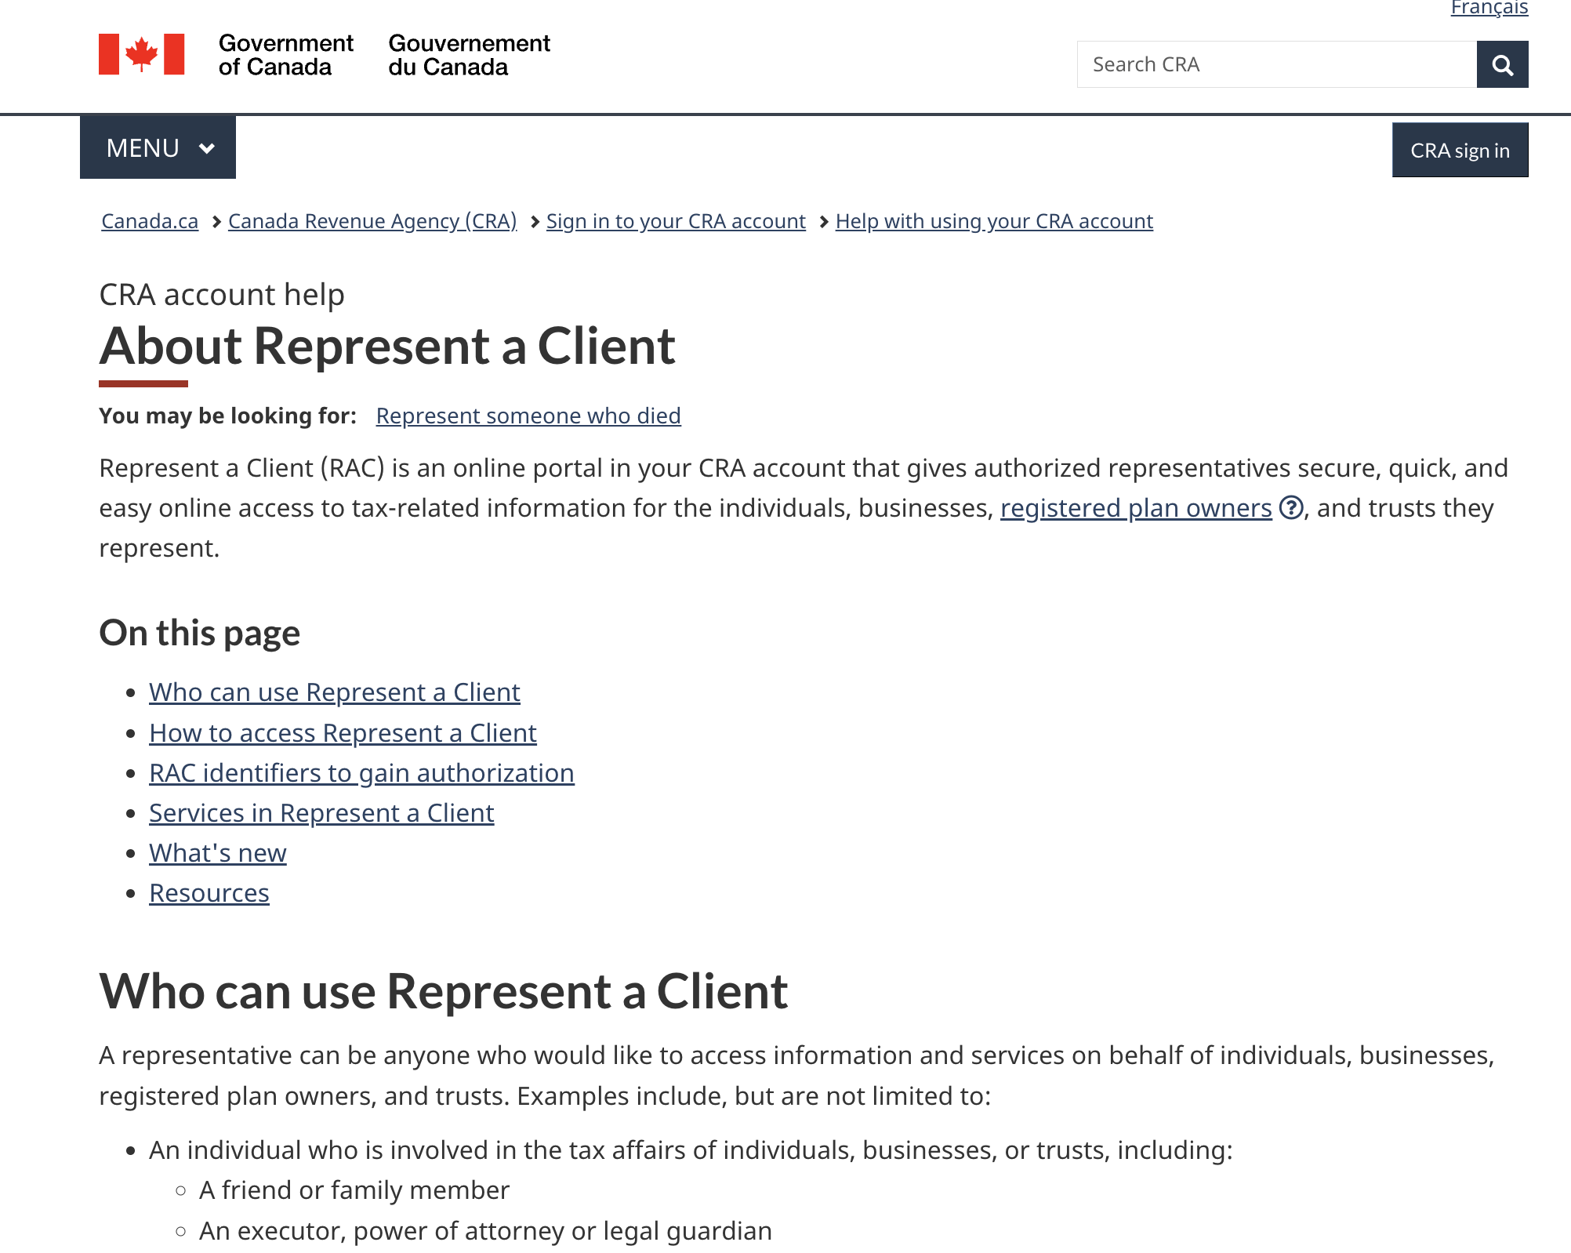
How does CRA support the Helpers?

Slide 7
RepID Benefits
CRA system can differentiate who did what
Rep doesn’t have to impersonate older adult
Rep can access tax documents, assessments, handle issues, etc.
Rep can use Autofill My Return
Rep can message CRA on behalf of older adult
Rep cannot change banking details or contact information

Slide 8
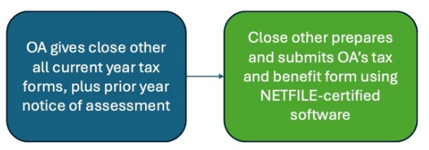
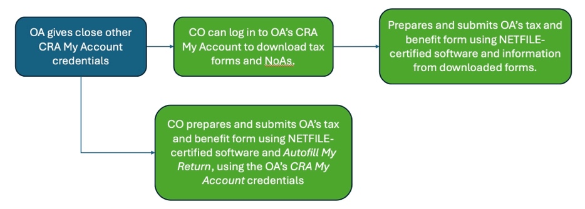
No CRA Access
To the CRA, this looks like the Older Adult filed taxes by themselves
Tax helper
tax helper
Older Adult Shares CRA My Account Credentials
tax helper
TH
Tax Helper can change bank deposit, contact info & make illegal benefits claims
TH

Slide 9
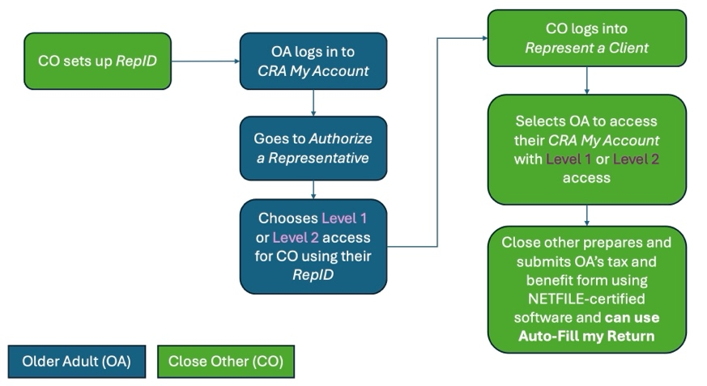
Older Adult Authorizes Tax Helper with RepID
TH
TH
Enters the tax helper’s RepID to give them access
CRA knows a helper filed on behalf of OA
Tax helper can’t change deposit or contact info
Tax Helper
TH

Slide 10

How do older adults file taxes?
How do informal tax helpers help?
Notes:
What is actually happening on the ground?

Slide 11
Interview Study (n = 19)
Older adults (n = 8)
CVITP volunteers (n = 6)
Informal tax helpers (n = 5)
Notes:
30 minutes, $15
60 minutes, $30
In person, on Zoom, over the phone

Slide 12
Results Summary
OAs using CVITP very satisfied
CVITP volunteers use various secure protocols to get limited CRA access, or file without it
OAs doing taxes themselves are satisfied
All are frustrated by CRA telephone support – long delays, lack of good answers, etc.
Informal Tax Helpers don’t know about and are not using RepIDs

Slide 13
“Um, I would log into their CRA my service account to retrieve their notice of assessment. And WealthSimple has like an integrated feature where you can log into the account and then it just pulls like all of the information. I do have like the paper copies of the forms as well, but I kind of use that process to double check and make sure that we have everything.” (Jen – tax helper)

Slide 14
‘‘I know that, if you like, go to an accountant or an actual authorized representative to do your forms, they can sort of put in, like, their representative ID and then it can, like, there’s an easy way for them to log in for you. And I wish there was something similar, but, like, maybe a little bit more informal.
Like, I do still think there should be that accountability of, like, ‘who filled this out?’
I wish there was a way to give authorization more informally so that I wasn’t like, ‘hey, give me your phone so I can log in for you and pretend that I’m you’.’’ (Harini – tax helper)

Slide 15
Takeaways:
CVITP volunteers access CRA accounts using secure mechanisms
3 million+ Canadians rely on informal tax helpers to do their taxes for them
Most informal tax helpers do not have RepIDs
Tax helpers using older adults’ CRA credentials ⬆︎ risk of financial misconduct
Informal tax helpers should use RepIDs
People who get help from friends/family should ask them to get RepIDs
CRA should better publicize (rename?) the Represent a Client system
Notes:
CRA needs to do a better job of making this option known
These delegation workflows could serve as models for other areas, such as online banking

Slide 16
References
Canada Revenue Agency 2022–2023 ePayroll Public Opinion Research. Nanos Research. (Registration Number: POR-135-22) ISBN: 978-0-660-49952-9
Canada Revenue Agency. (n.d.-b). About Represent a Client. Retrieved November 10, 2024 from https://www.canada.ca/en/revenue-agency/services/e-services/represent-a-client/about-represent-a-client.html
Canada Revenue Agency. (n.d.-c). Auto-fill my return. Retrieved November 10, 2024 from https://www.canada.ca/en/revenue-agency/services/e-services/about-Autofill-return.html
Canada Revenue Agency. (n.d.-dd). File your taxes online: Understand NET-FILE. Retrieved November 10, 2024 from https://www.canada.ca/en/revenue-agency/services/e-services/digital-services-individuals/netfile-overview.html
Canada Revenue Agency. (n.d.-e). About free tax clinics. Retrieved November 10, 2024 from https://www.canada.ca/en/revenue-agency/services/tax/individuals/community-volunteer-income-tax-program.html
Petit, G., Tedds, L. M., Green, D., & Kesselman, J. R. (2021). Re-envisaging the Canada revenue agency—From tax collector to benefit delivery agent. Canadian Tax Journal, 69, 99.
Wiebe L, Havens Z, Khan M, Latulipe C.
Older Adults and Tax Delegation in Canada: A Sociotechnical Analysis.
Canadian Journal on Aging / La Revue canadienne du vieillissement.
2026;45(1):103-116.

Slide 17
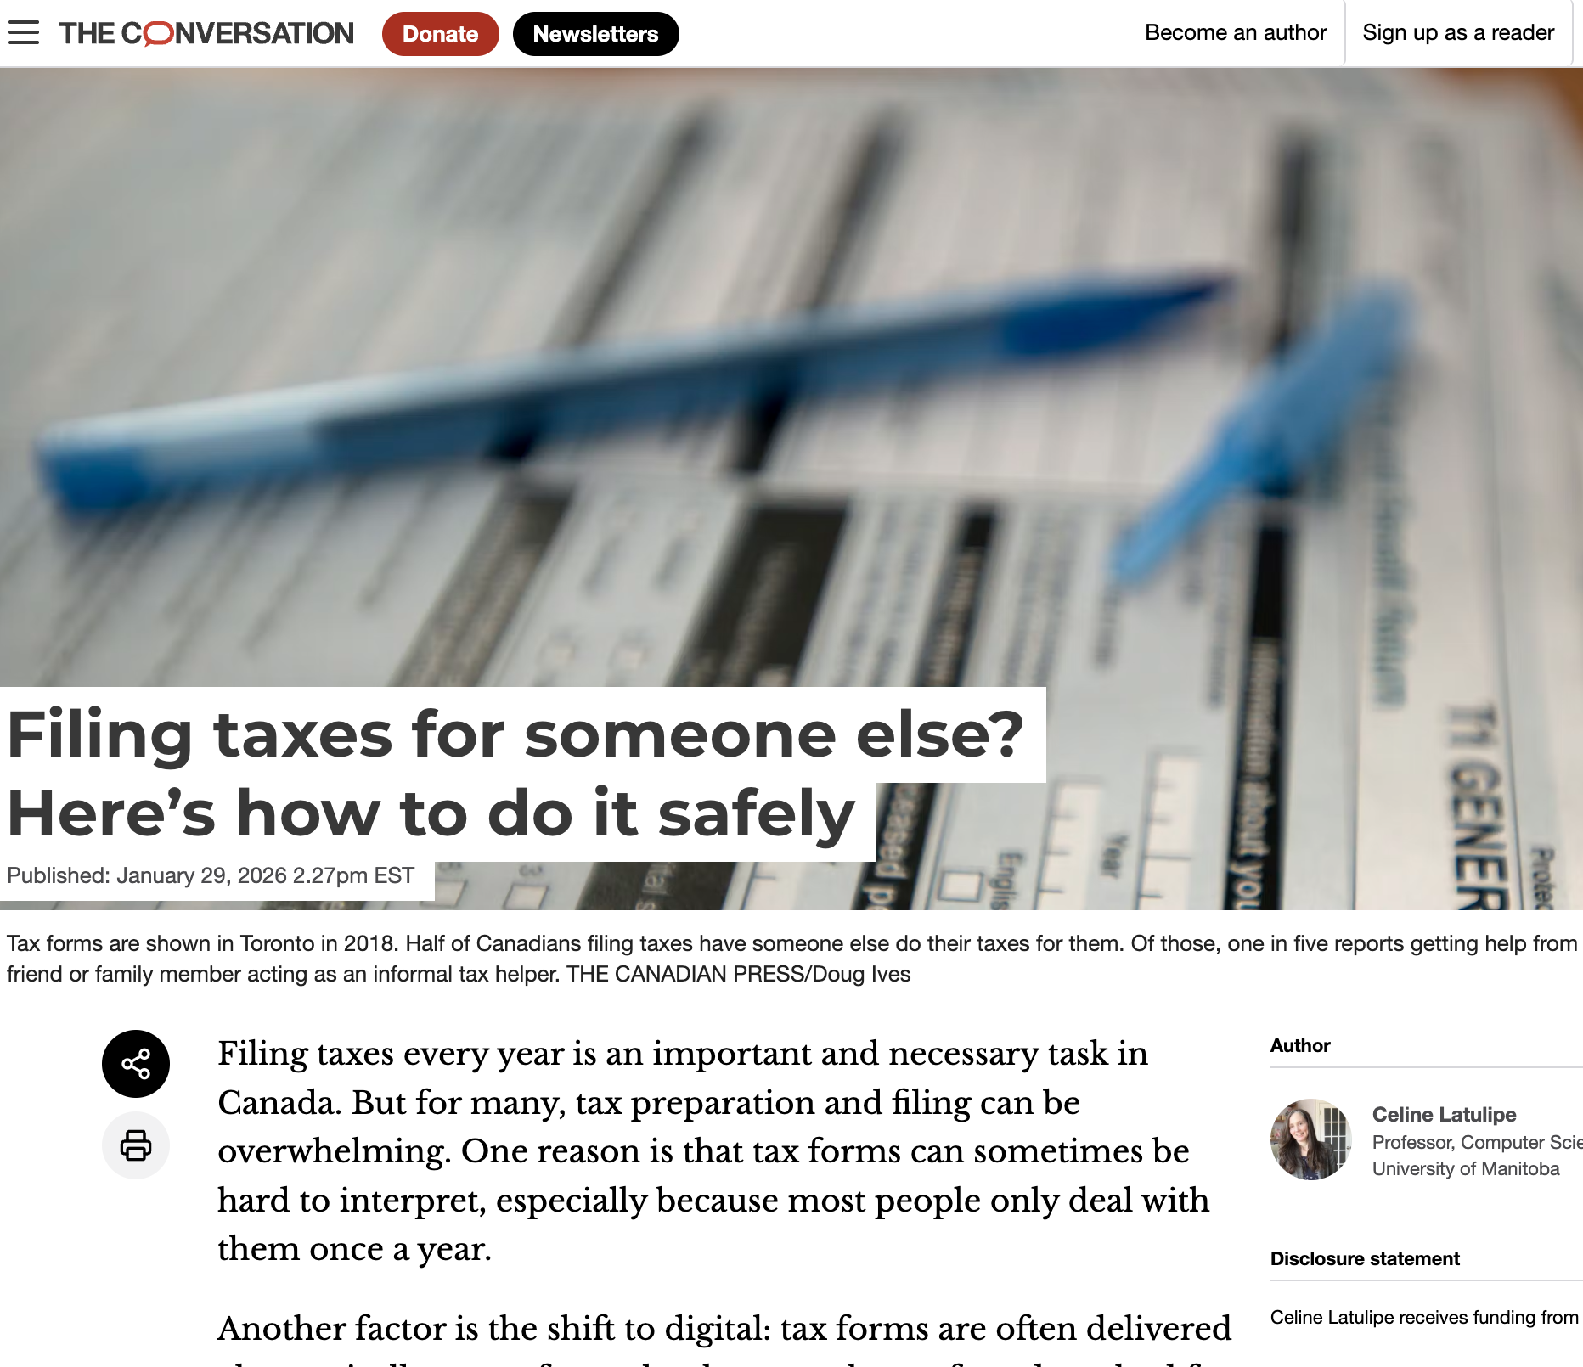
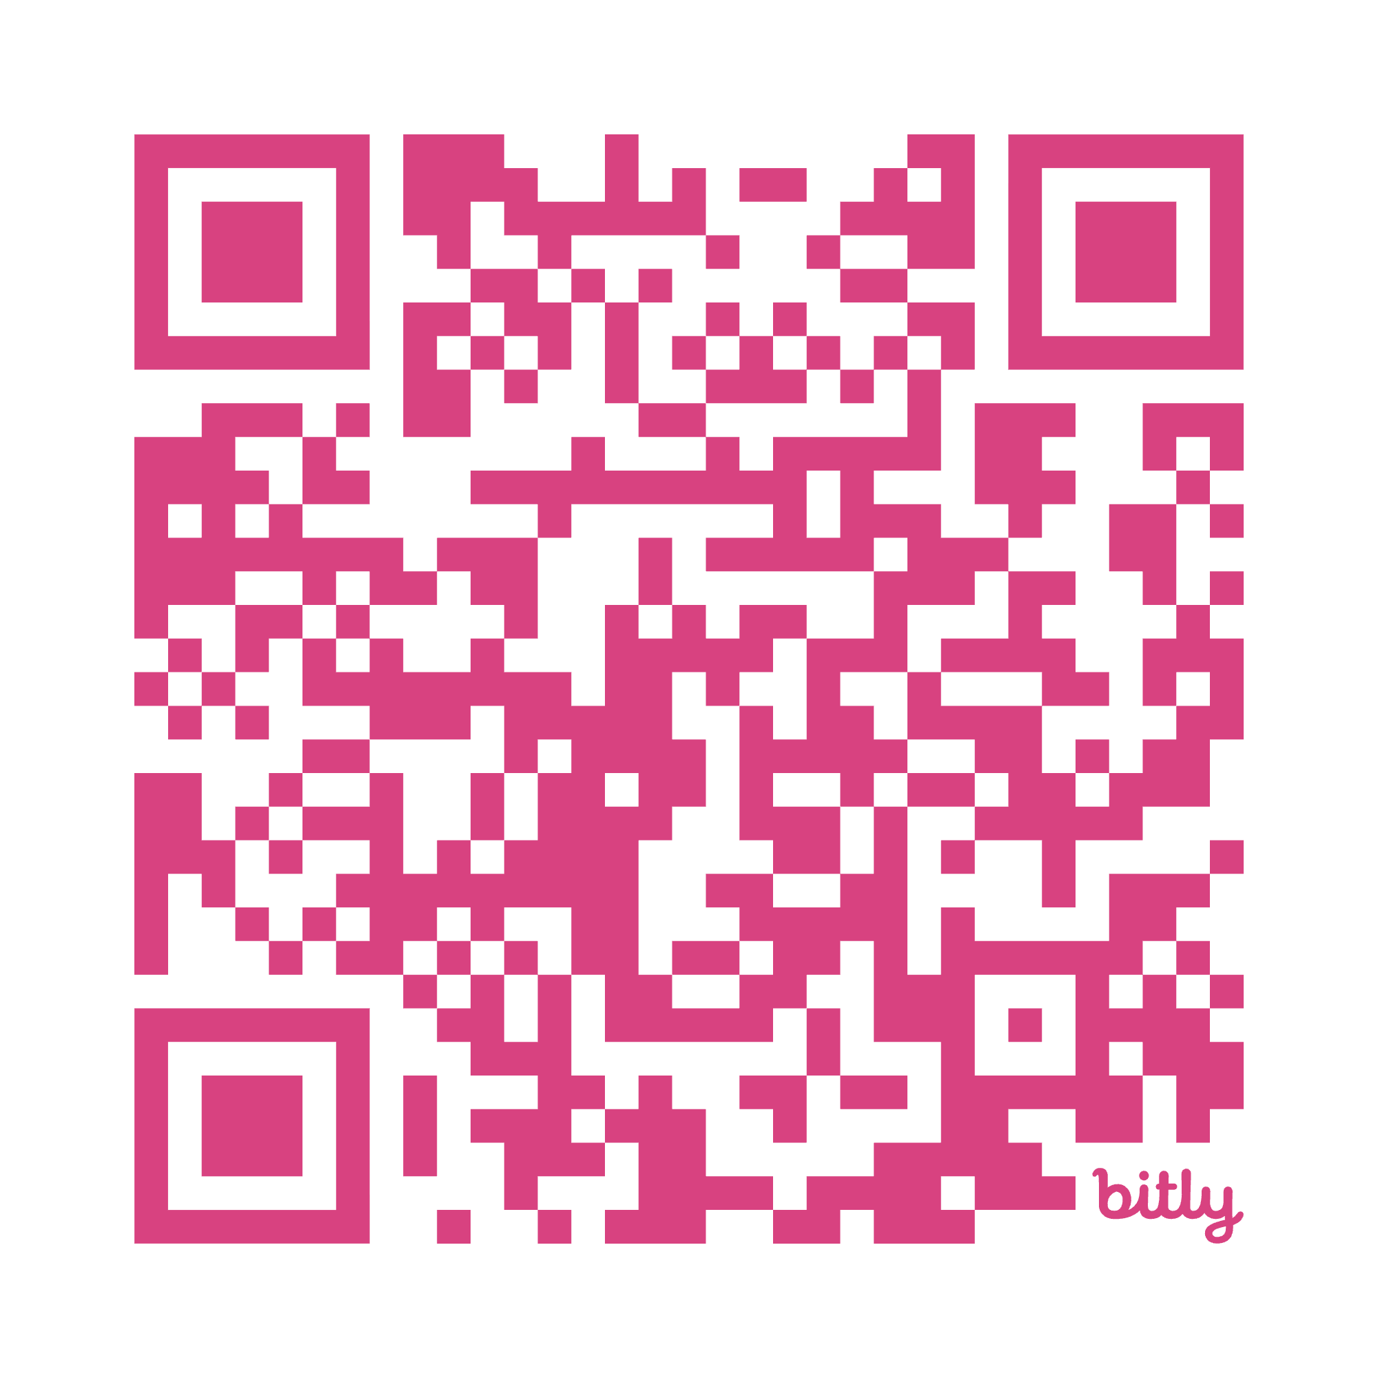
Questions?
celine.latulipe@umanitoba.ca

Slide 18
Arthur is a retired auto mechanic who spends a lot of time puttering around in his garden and his garage. He’s not into technology and has never really been a big numbers person. Arthur has typically gone to H&R Block to get his taxes done. But Arthur’s grandson, Tom, who is a business major in college and very tech savvy, offers to take over and file Arthur’s taxes for him. Tom tells Arthur he can do everything quickly and easily with his tax software and it will be free.
Tom asks Arthur for his CRA login credentials so that he can access Arthur’s tax forms.
Tom uses Arthur’s CRA credentials to log in to his CRA My Account and file Arthur’s taxes. But while in there, he also applies for benefits that Arthur doesn’t qualify for and changes the email and postal mailing address and bank auto-deposit details in the CRA account so that the notice of assessments are mailed to Tom and the tax refund and (illicit) benefits go to his bank account. Tom creates a fake Notice of Assessment with a smaller refund amount and gives the smaller amount and fake NoA to Arthur.

Slide 19
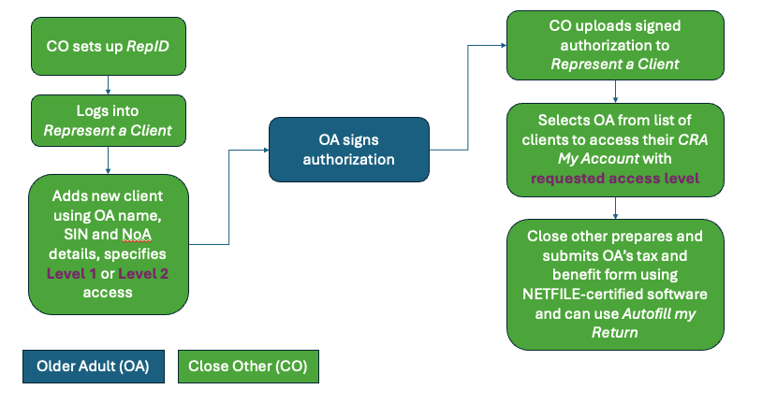
Close Other Uploads Signed Authorization from Older Adult
CRA knows RepID filed on behalf of OA
Close other can’t change deposit or contact info

Slide 20
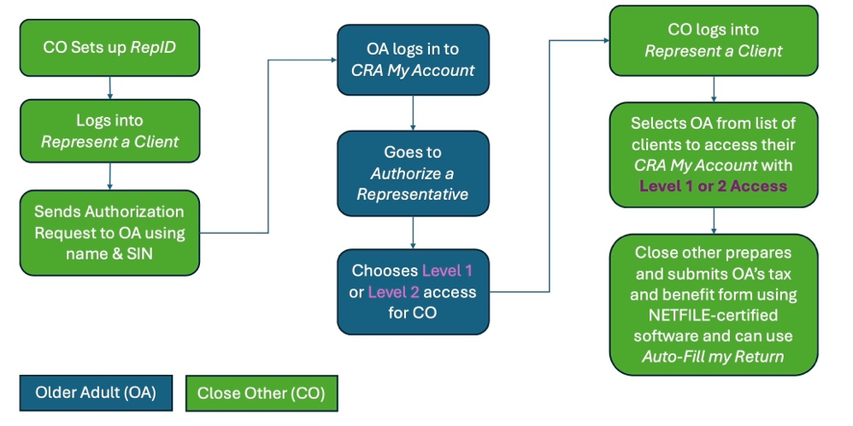
Workflow 3b: Close Other Requests Authorization from Older Adult
CRA knows RepID filed on behalf of OA
Close other can’t change deposit or contact info

Slide 21
…this is my 1st year doing it, and it was very confusing about what was the right way to do things…I basically filed her taxes like as if I was her, right, not as a representative. I don’t think that’s completely legal. I don’t think it’s completely illegal, right, like she was there the whole time. And like, there’s these weird gray areas, and like, there’s so many edge cases. (Darren – tax helper)

